Slide 1

Week 2: Research Ethics
Research Methods for IT

Slide 2
Welcome!
Please sit in your A, B ,C , D or E zones again!
If you are new, sit anywhere for now and we will be in touch at the end of the week with your group number!

Slide 3
Workshop expectations
Before the workshop:
Watch the week’s videos, read the associated work. Complete the weekly quiz on Moodle in prepararation for the workshop (5% of your overall mark).
During the weekly 3-hour workshop:
3-4 activities:
Work in small groups of 3-4 students on each activity
Record your work on shared (online or in-person) worksheet
Share your group’s work with the rest of the workshop.
Before the end of the week:
Complete your contribution statement as part of your weekly consolidation activity, (5% of your overall mark)
Consultations:
If you have any questions about the material or workshop examples, talk to your tutor and attend the weekly consultations, details on the unit page. Also post your question on the Ed Discussion forum.

Slide 4
Workshop Activities
Workshop activity sheet: Moodle > Week 2 > 3. Studio Activity
Activity 1: Develop your own examples of (and responses to) ethical issues
be able to illustrate ethical issues with your own examples
Activity 2: Apply some of the ethics concepts in the analysis of existing research
consider a piece of research and “spot” potential ethical issues
Activity 3: Consider practicalities of undertaking research in an ethical manner
start to understand complexity of managing ethical issues in research

Slide 5
Activity 1:Dimensions of Research Ethics
(40 mins + 10 mins review)
Physical/psych harm/abuse
Informed consent
Right of withdrawal
Vulnerable participants
Deception
Coercion
Illegal practices
Invasion of privacy
Confidentiality
Activity 1: work in groups to:
Discuss each ethical dimension
Come up with examples of research activities that raise an issue for each ethical dimension.
Example: someone wants to run a study to find out how good people are on doing simple mathematics, so they stand outside H Building in Caulfield campus and ask students entering to answer some simple maths questions. Issue: Informed consent.

Slide 6
Activity 1: Example 1
Example 1: You are doing research on how barista staff use a new coffee making machine.
You are using video to study their use in the shop, videoing staff members who have consented to take part in the study.
Occasionally the video captures people who have not consented to take part in the study.
Informed consent: not everyone videoed.
Privacy: no consent to video some people.

Slide 7
Activity 1: Example 2
Example 2: You are doing a study of how people use Facebook to talk about politics.
This involves scraping comments from a public Facebook group and classifying them as “friendly”, “neutral” & “hostile”
When you publish examples of comments you use examples of “hostile” posts.
Informed consent: have people consented?
Confidentiality: people can find the name of authors of your “hostile” post examples.
Psychological harm: authors of “hostile” posts put at risk of psychological abuse.
Notes:
After this activity please have a 10-minute break.

Slide 8

Activity 1 Dimensions of Research Ethics
Group Work

Slide 9

Activity 1: Dimensions of Research Ethics (Discussion)
Now we will share our thoughts…

Slide 10
Activity 2 (30 mins + 15 mins review) Reviewing Actual Research for Ethical Issues
Hudson, S., Fogarty, J., Atkeson, C., Avrahami, D., Forlizzi, J., Kiesler, S., Lee, J. and Yang, J., 2003, April. Predicting human interruptibility with sensors: a Wizard of Oz feasibility study. In Proceedings of the SIGCHI Conference on Human factors in Computing Systems (pp. 257-264).
Hudson et al. (2003) was a paper that was mentioned in the Week 1 videos (simulation):
Observing the interruptibility of office workers
Used a camera and microphone to capture people working in an office
Subjects given audio prompt and self-reported their interruptibility
Manual analysis of the video/audio data to establish when the activities were occurring
What are the potential ethical issues?

Slide 11
Activity 2 Reviewing Actual Research for Ethical Issues
Familiarise yourselves with the paper (Moodle)
Read “Intro” and “Study Details” sections
Identify:
Aspect of research design with ethical issues
What the researchers said about these (if any)
How you would propose to address the issue
For example:
ASPECT OF RESEARCH DESIGN: there are only 4 participants, all from the same institution as the researchers, do they really understand who is going do see the data (informed consent) and do they feel pressured to take part (coercion).
AUTHOR DESCRIPTION: does not describe the issue, does not describe the recruitment process.
YOUR PROPOSAL: give member full details of the identities of who is going to see the videos and give them time to reflect on this before confirming participation (informed consent); advertise for participation widely and make “opt-in”, rather than targeting specific people (coercion).

Slide 12
Activity 2: Example 1
ASPECT OF RESEARCH DESIGN: inappropriately capture people and audio in during the activity, there are many reasons why this might be inappropriate: (i) additional people not consented; (ii) content might be sensitive; (iii) there might be a conflict of interest between a person paid to do the annotation and the person or process being discussed.
AUTHOR DESCRIPTION: “a keyboard which allowed the user to temporarily disable recording if they felt their conversations were too sensitive to be recorded (to ensure privacy, subjects could also retroactively request the recordings from any time period be destroyed prior to viewing).”
MY PROPOSAL: the durations of the recording sessions were very long, and the mechanism by which people could retroactively have recordings is not clear. Instead, use shorter recording sessions and ask subjects to review recording and remove elements they think are inappropriate before giving to the research team.
Notes:
SLIDE 1 (OF 2) TO FINISH OFF THE DISCUSSION (IF NEEDED).

Slide 13
Activity 2: Example 2
ASPECT OF RESEARCH DESIGN: Duration of recordings for each subject are very long. The idea that you all you activities are recorded on video and reviewed by research is likely to cause psychological harm (stress). Also given the number of subjects is small the perceived “damage” (to the study) of withdrawing from the study is high (more stress).
AUTHOR DESCRIPTION: “7am to 6pm on workdays for 14-22 days for each subject” but no discussion of the stress that this is likely to cause subjects.
MY PROPOSAL: use more subjects, for shorter periods, allow them to review footage, continuously check that they are happy to continue (by asking for their consent at each session).
Notes:
After this activity please have a 10-minute break.

Slide 14
Activity 2: Reviewing Actual Research for Ethical Issues (Discussion)
Now we will share our thoughts…

Slide 15
Activity 3: Processes, People & Documentation
(20 mins + 10 mins review )
Consider a scenario in which your company is moving to a hybrid working model.
As a developer at the company, you have been asked by your line manager to investigate how distracting hot-desking and hybrid working conditions will be to the development team.
To do this, you will repeat Hudson et al’s (2003) study on interruptibility using 20 of your colleagues who work in your area of the office.
To do this you will first need to develop and submit a research proposal to your company's Ethical Practice Board
In preparation for this submission you must think through all the ethical issues, how you will address them, and what documentation you will need to ensure that the study is conducted as you propose.
1. Processes:
Recruitment
Conduct of observations
Data analysis
Data curation
2. People
3. Documentation

Slide 16
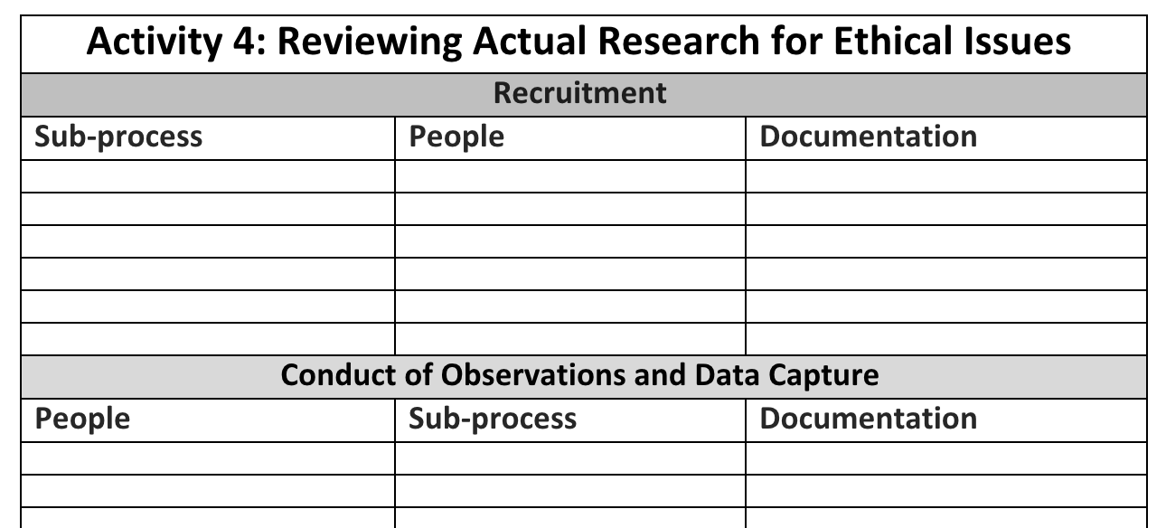
Activity 3: Processes, People & Documentation
Choose one section in the activity for recruitment, data capture, data analysis or data curation. If you finish early choose another section.
Identify:
Steps (subprocesses) involved
People who might be involved.
How you would document the subprocesses.
Consider all these factors a reminder that you would need approval from the ethics committee.
Example on next slide

Slide 17
Activity 3: Processes, People & Documentation
Writing an ethics proposal is an important part of the ethics approval and review process.
An excellent application will show that you considered all parts of your study proposal design as well as your potential research participants.
Recruitment
Sub-process | People | Documentation
For example: Consider the activities (sub-processes) which are involved in the stages of the recruitment process. | Consider which people are involved at each stage of the recruitment process. | Consider the documentation for each activity, in the recruitment process.

Slide 18
Activity 3: Example
For example:
Sub-process: ”Advertising” part of “Recruitment”: how you get initial interests from potential subjects.
People: (i) potential participants, (ii) person sending out the advert, (iii) person responding to subject replies; (iv) person for complaints to be made to.
Documentation: (i) text of the advert (poster); (ii) text of the advert (email or social media); (iii) checklist to filter people if they respond to the advert; (iv) process and script for person responding to potential subjects (if interested); (v) process for responding to complaints about the advert; (vi) spreadsheet to record advertising and responses…
There are many steps to each process, and many people involved…

Slide 19
Activity 2: Reviewing Actual Research for Ethical Issues (Discussion)
Now we will share our thoughts…

Slide 20
Activity 3: Example for ‘recruitment’
Recruitment
Sub-process | People | Documentation
Advertising Identifying potential subjects | Potential subjects (respond to advert), Research team (review responses), Admin staff (distribute advert and communicate to subjects); Independent person (for complaints about process) | Paper advert (posters); Electronic advert (email & social media); List of responses to advert (e.g. contact details); script (for responding to questions about advert).
Selection Moving from potential to actual subjects | Potential subjects, Research team (check suitability workspace), Subject’s colleagues (check they are aware of student and have no concerns); Independent person (for complaints about process) | Explanatory statement (for subjects and subjects’ colleagues); Workspace checklist & procedure (process for research team to check the office location’s suitability)
Consent | Potential subjects, Research team (check suitability workspace), Subject’s colleagues (check they are aware of student and have no concerns); Independent person (for complaints about process) | Consent form (for subjects and colleagues); List of annotators (to allow subjects identify conflicts); Subject details & schedule (contact details and times for observations).

Slide 21


